Slide 1
PF2 regression (PF2R)

Slide 2
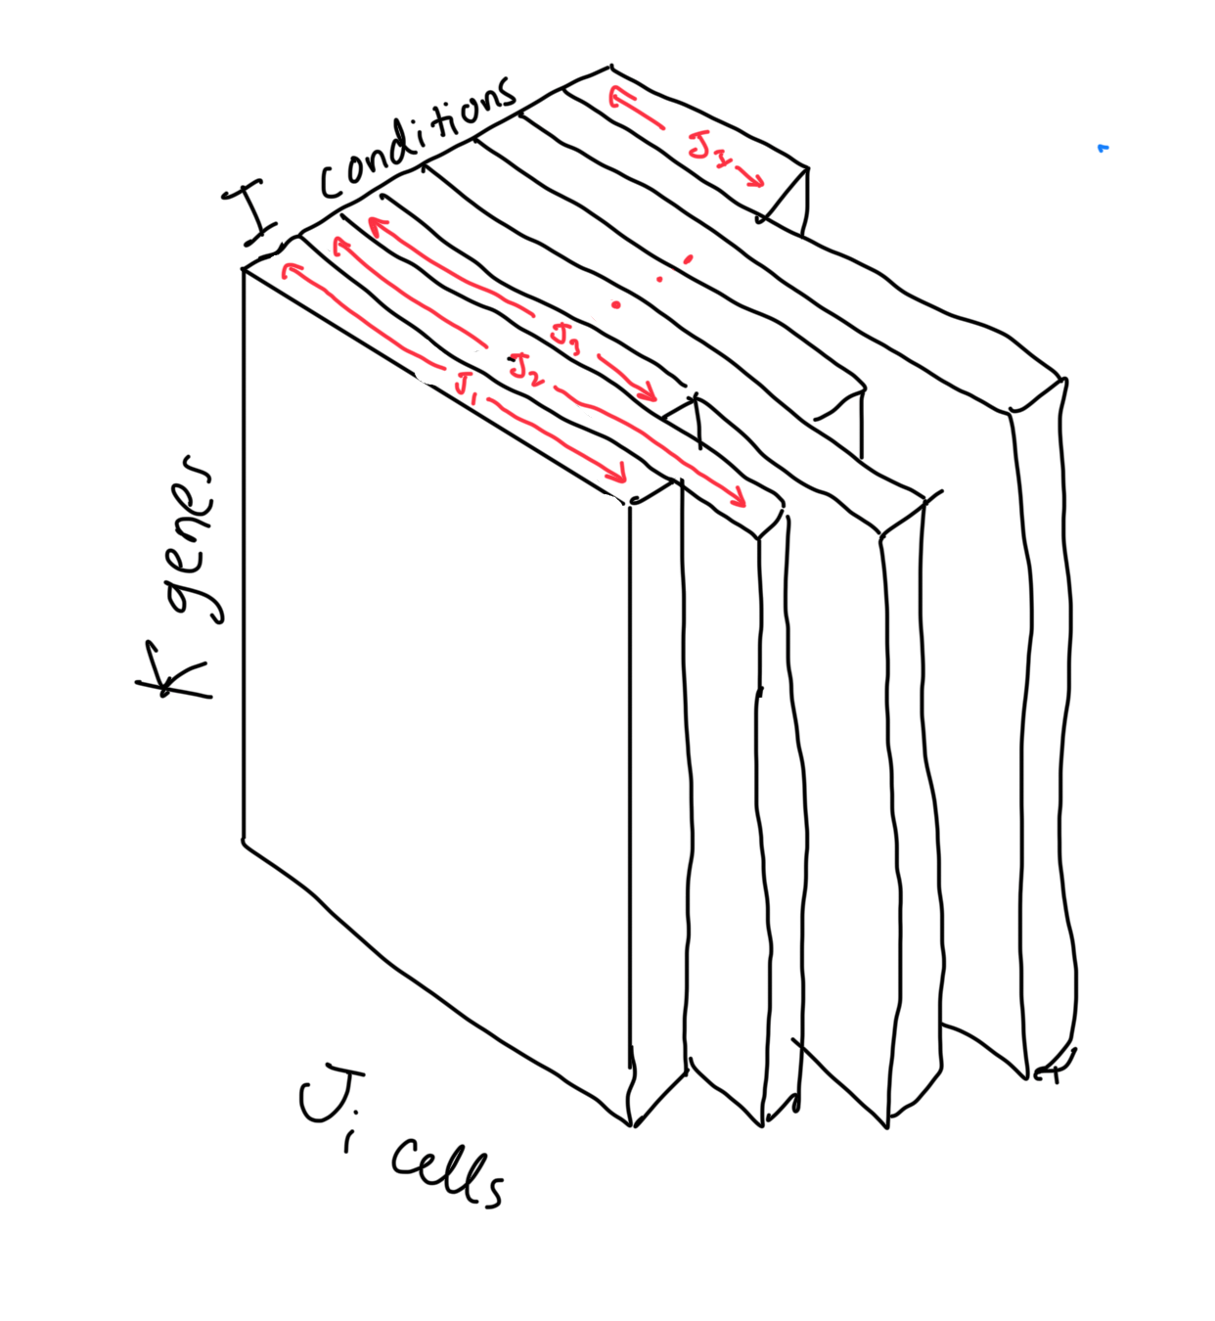
Parafac2
Consider a scRNA dataset X
Parafac2 (Pf2) seeks to reconstruct X as a sum of components.
In the same spirit as principal components analysis (PCA) or parafac.
Represents X with fewer dimensions than the original data.
Each component often represents a real biological pattern.
These components greatly simplify interpretation.
Pf2 is unsupervised, meaning it takes in no other information about X – only the gene expression quantities – and seeks to learn patterns that explain this data.

Slide 3
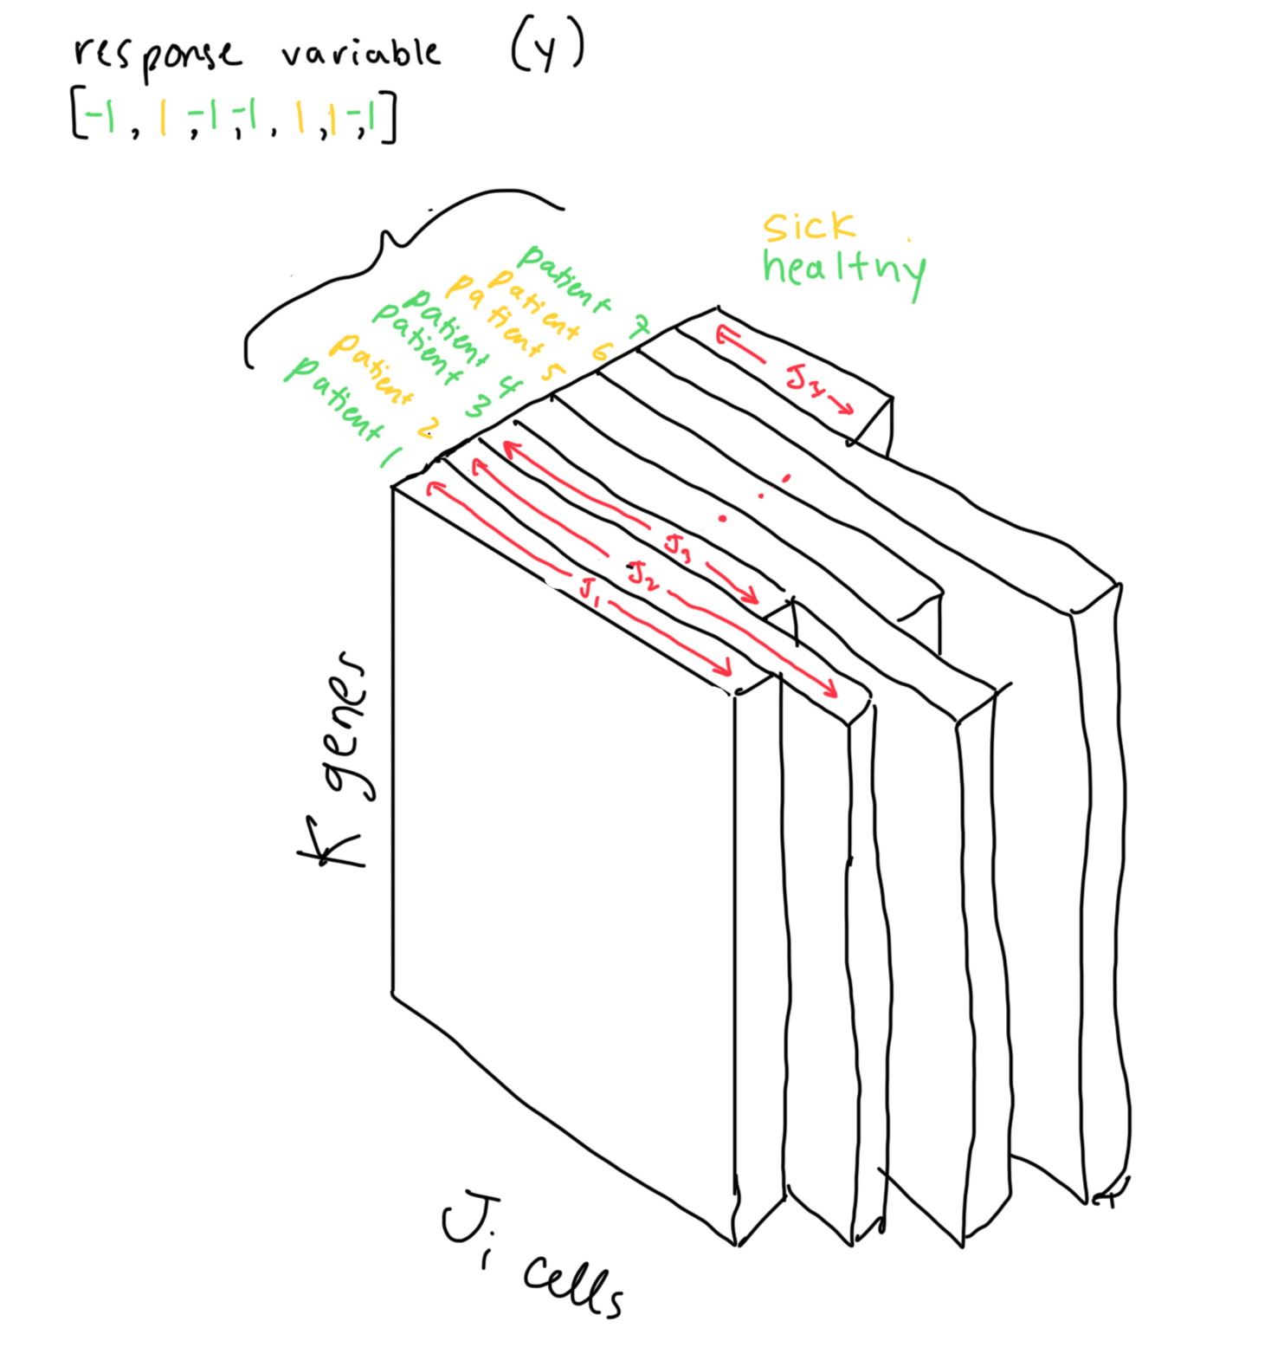
Pf2 for explaining differences between groups of samples
In many cases, we want to specifically know what the differences in X are between two groups (e.g., sick vs healthy).
Approaches:
Examine raw data directly.
Correlations between average gene expression and response variable (y).
Linear regression on average gene expression.
Run pf2 → linear regression on pf2 results.
Advantages over raw data:
Eliminates noise / reduces overfitting.
Reduces dimensionality, stabilizes regression coefficients.
Addresses collinearity in individual gene quantities.
However, there is no guarantee that the most prominent patterns of gene expression in X are also relevant to y, in which case running linear regression on the pf2 results is limited.
Notes:
Raw data difficulty
Use Pf2 to identify components that represent X in a compressed form
Perform regression using the weight of each component
Cannot even use linear regression model without, e.g., averaging due to varying number of predictors
Groups of samples isn’t even quite right

Slide 4
Pf2 for explaining differences between groups of samples
Ideally, we want a way to automatically construct simplified “components” in X that are directly relevant to y.
One analogy for our situation is:
We have found a type of principal components analysis (PCA) for scRNA-type data.
Now we want a type of partial least squares regression (PLSR) for scRNA-type data.
PLSR identifies components which maximize covariance with respect to response variable.

Slide 5
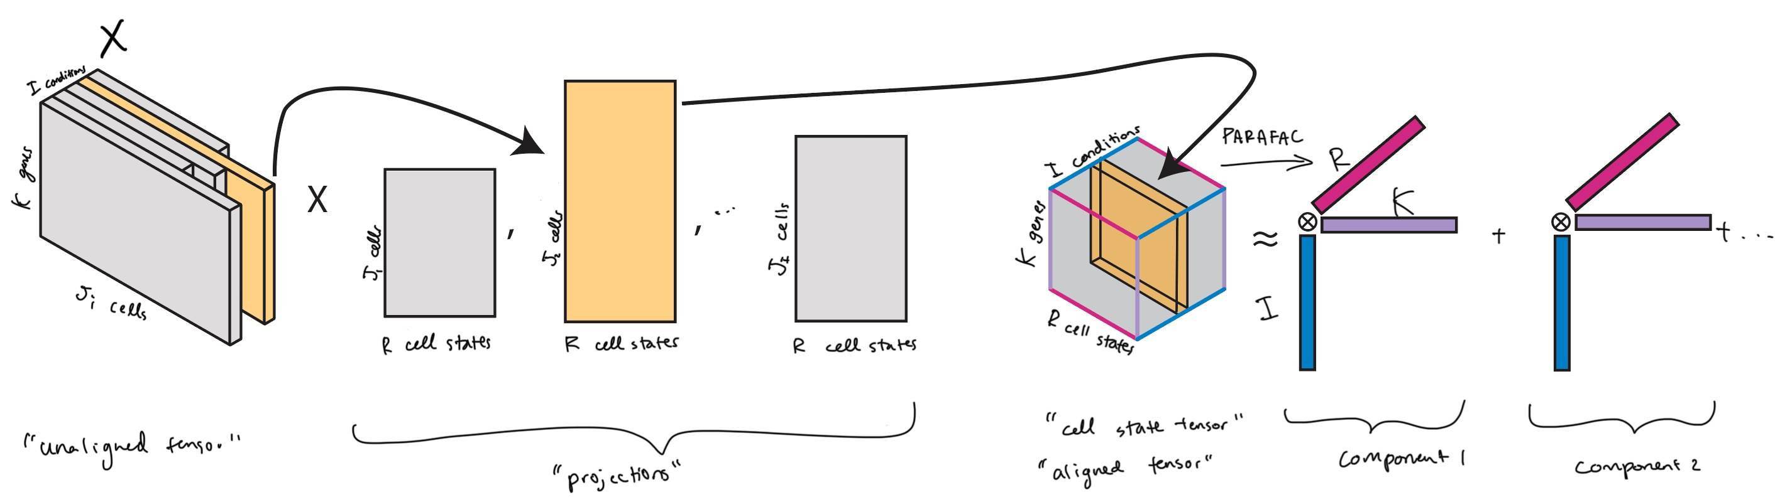
Preface – PF2
The unaligned nature of scRNA precludes the use of many tensor decomposition methods such as PARAFAC.
The PF2 direct fitting approach involves (1) fitting a set of matrices to transform each slice in X to a consistent shape (2) running PARAFAC on the resulting aligned tensor.

Slide 6
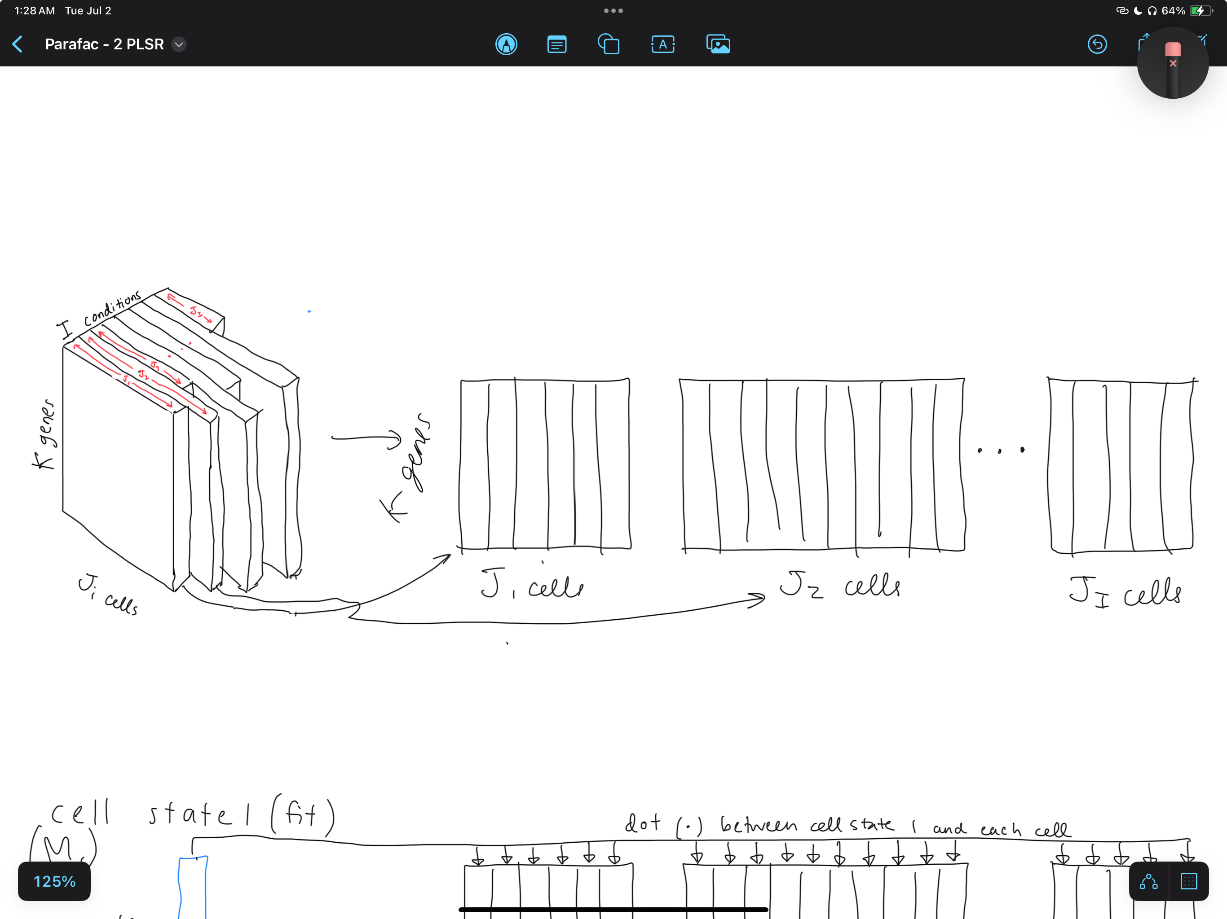
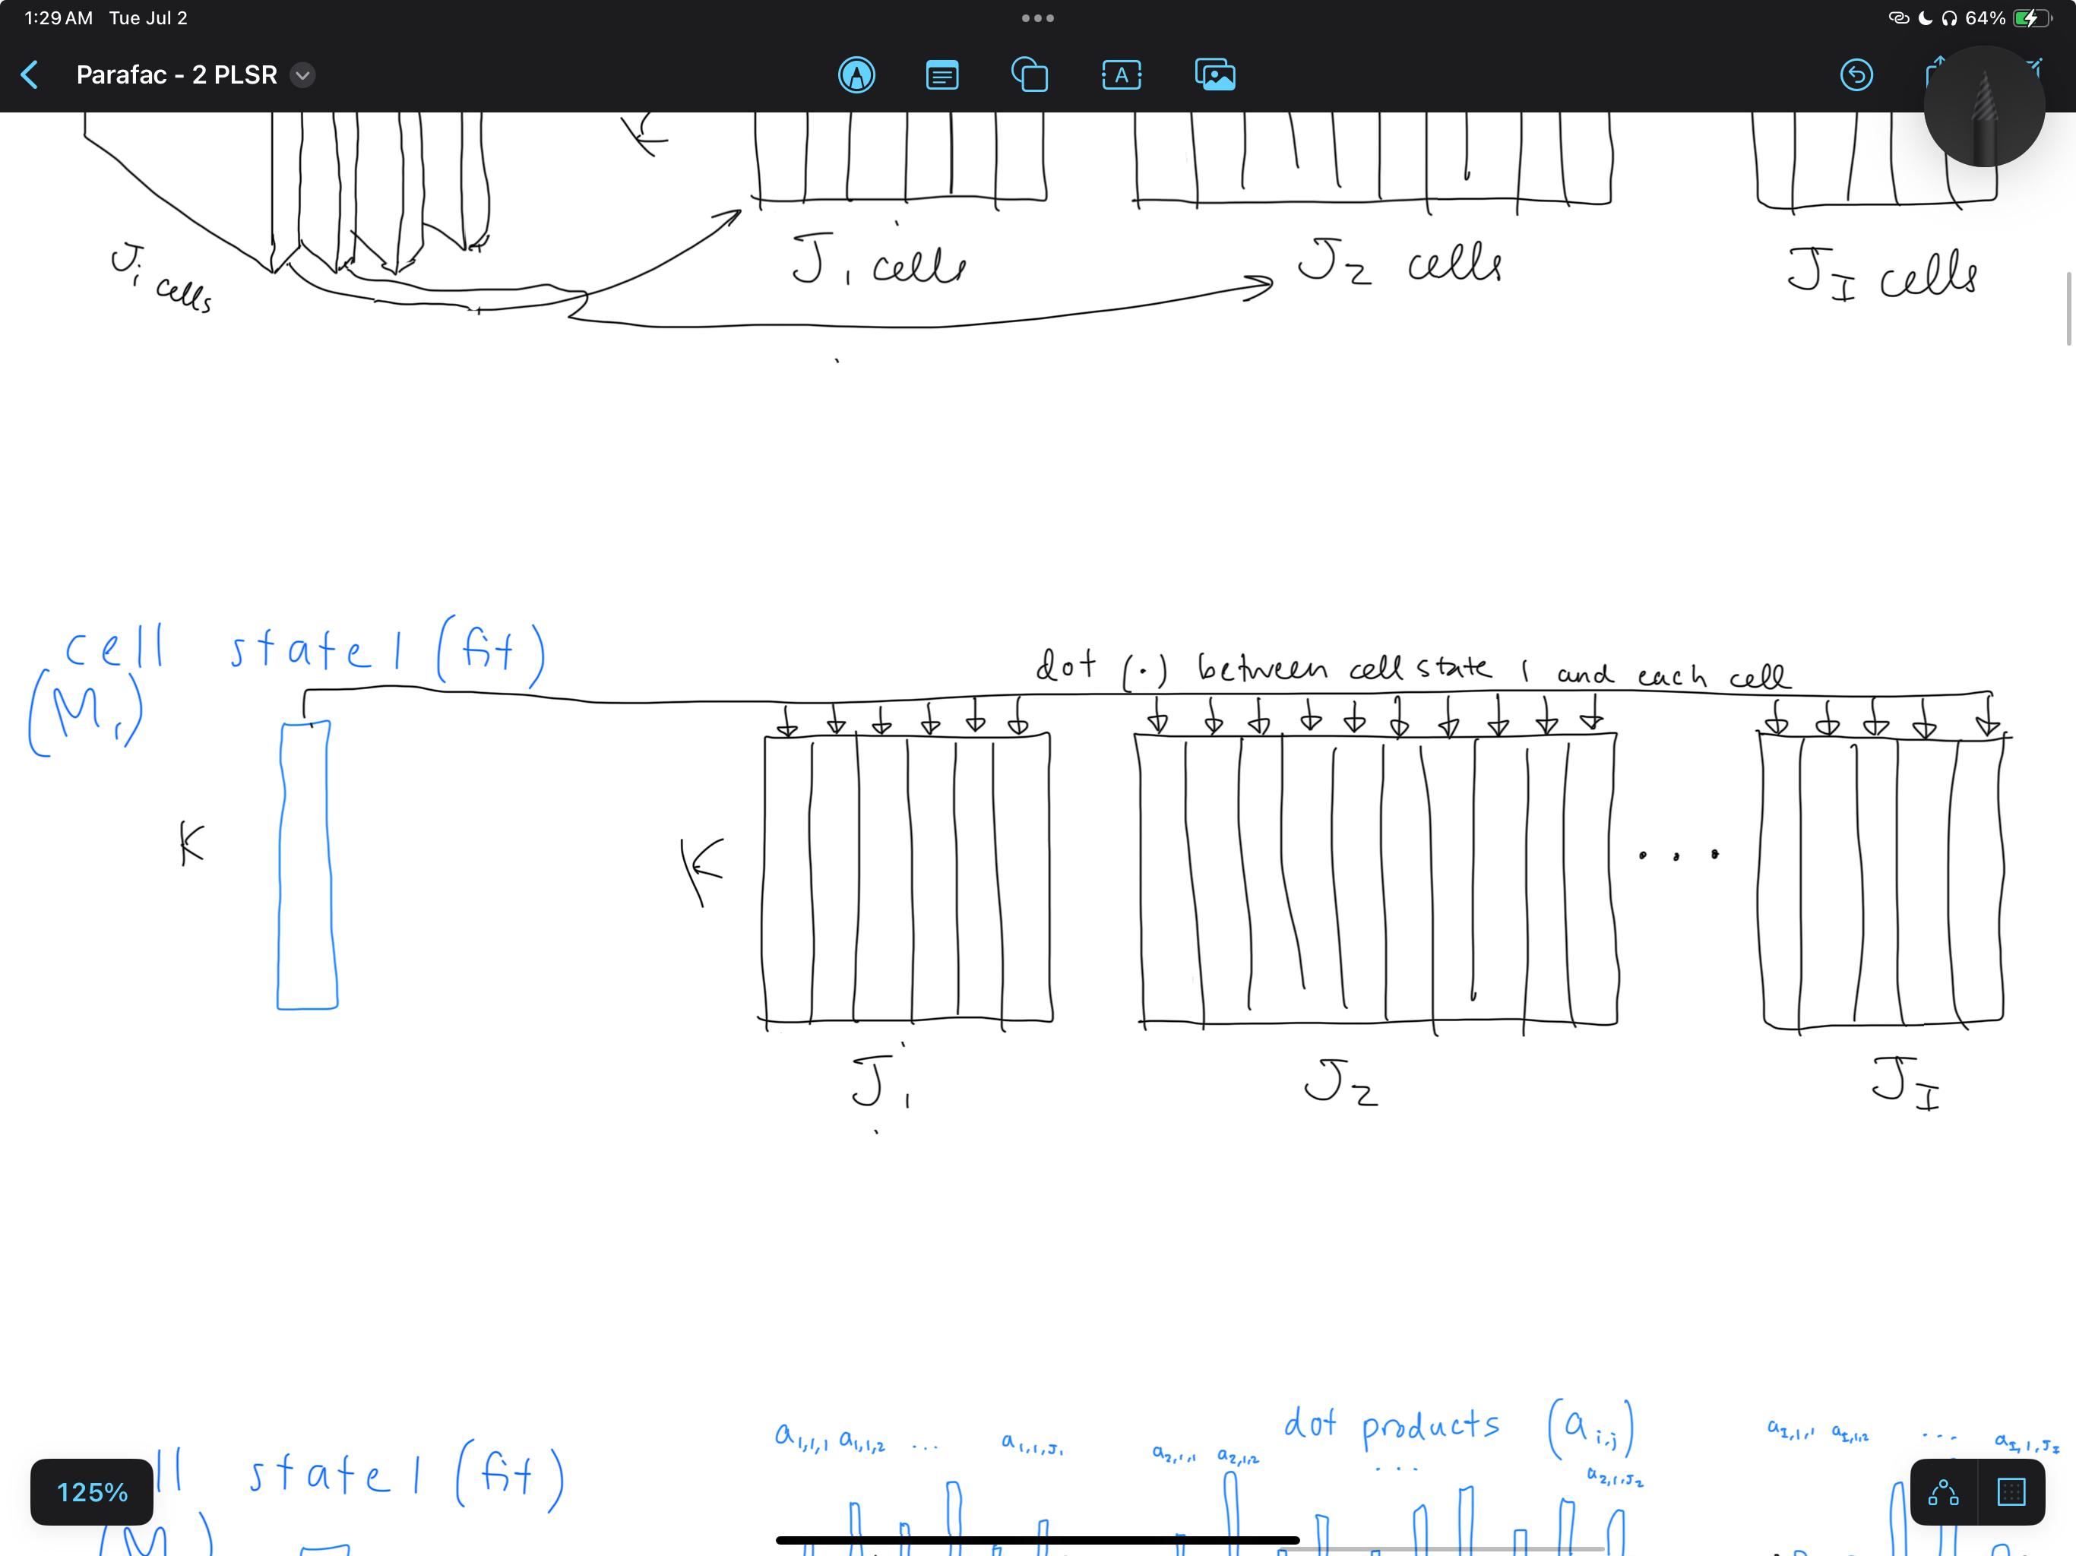
PF2R

Slide 7
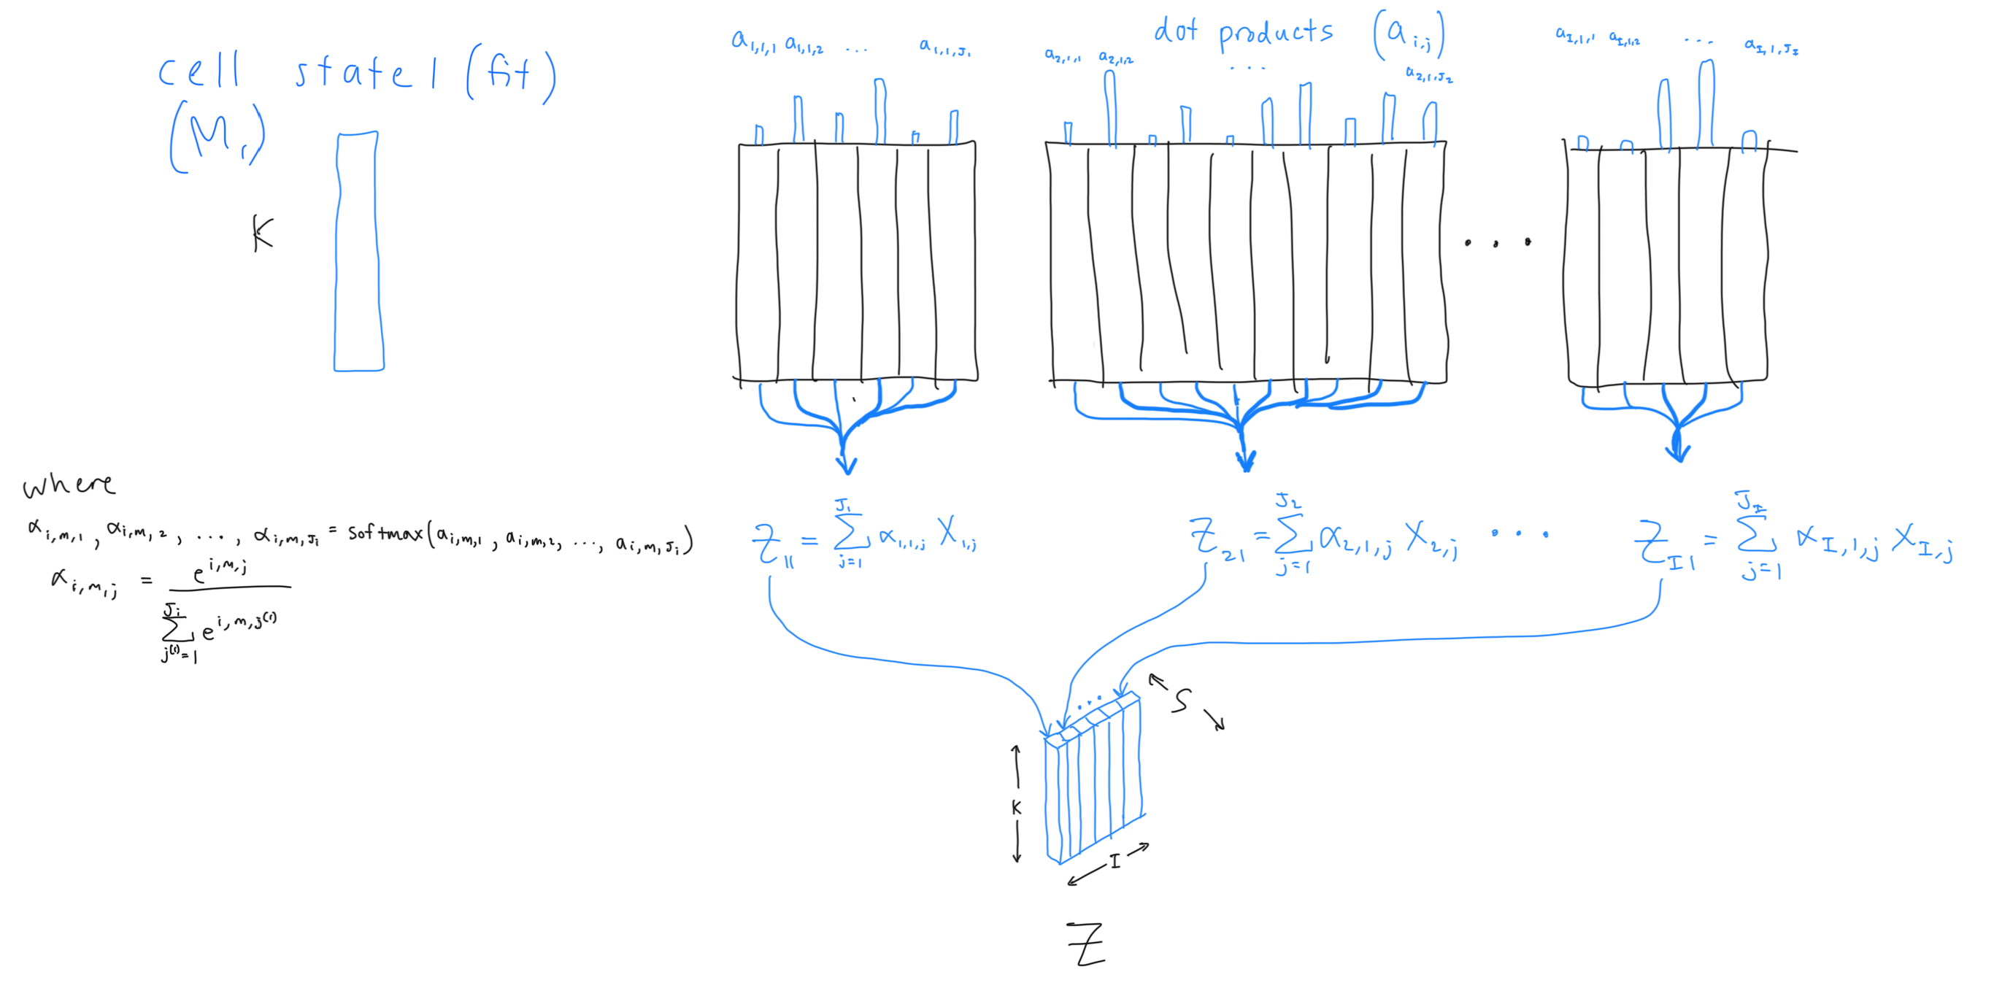
PF2R
Cell state 1

Slide 8
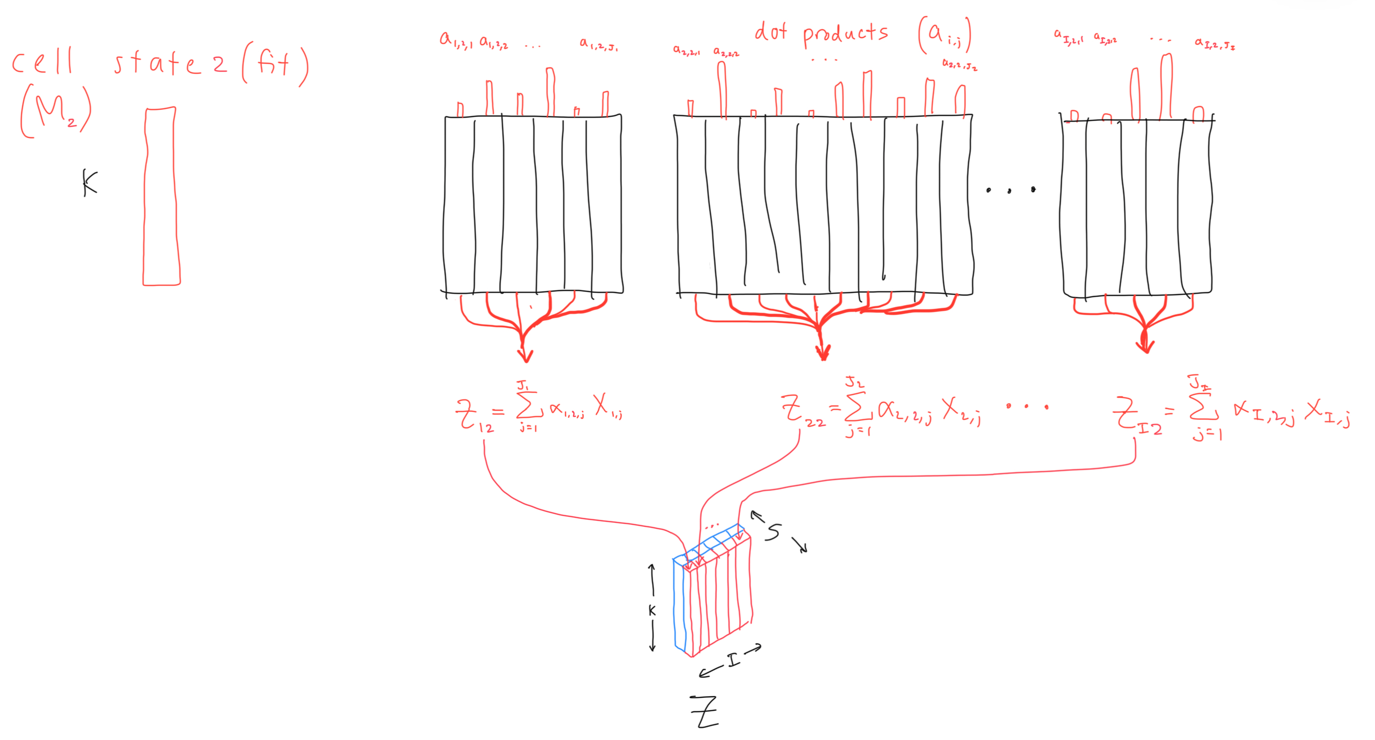
PF2R
Cell state 2

Slide 9
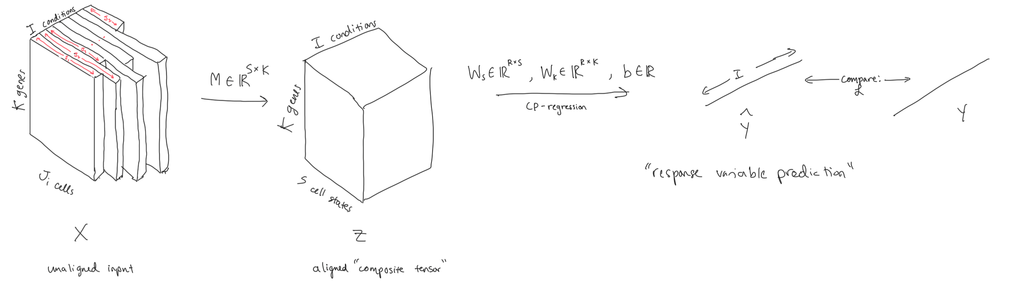
PF2R

Slide 10
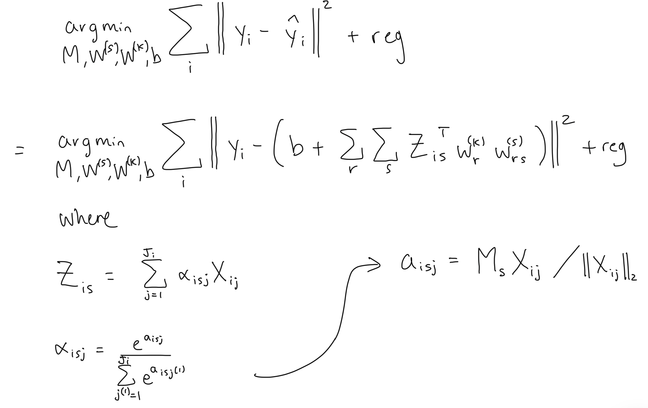
PF2R - Math

Slide 11
Regularization
One issue is that K > I, and thus the CP regression problem is ill-conditioned
Regularizing W_{k} may help with this
L1 regularization
L2
L1 + L2 (Elastic net)

Slide 12
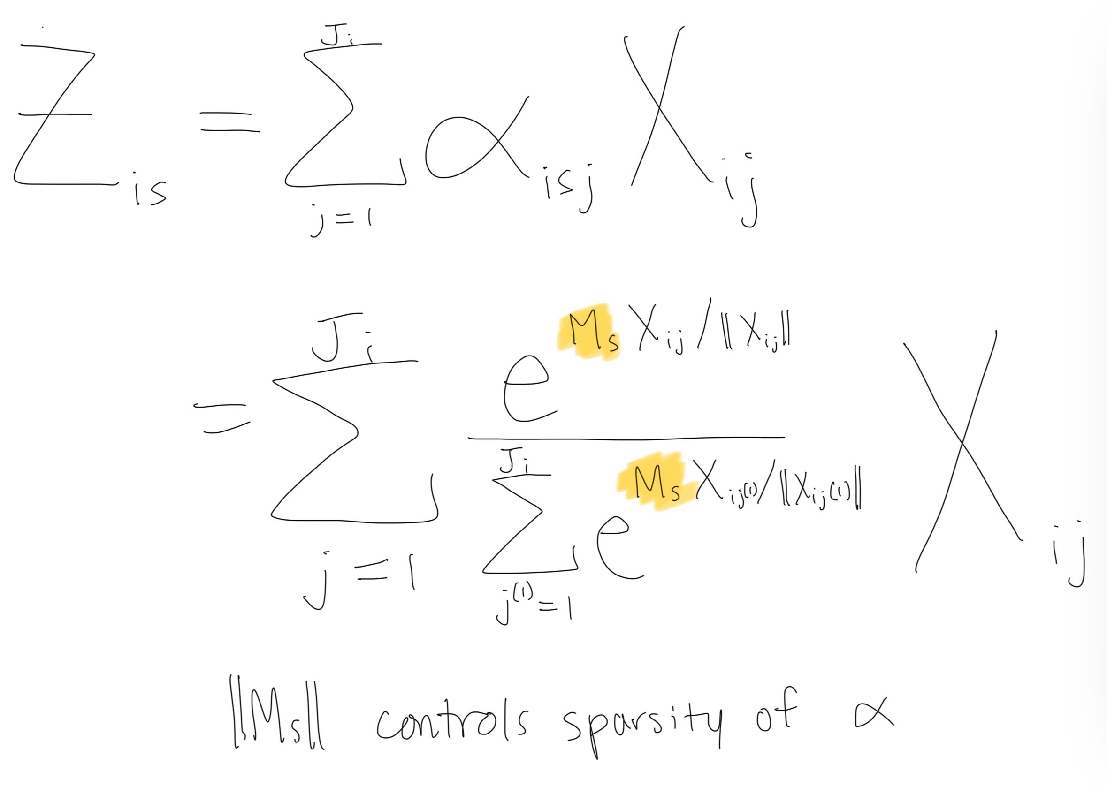
Regularization
We can add regularization to encourage M_{s} to get bigger (more sparse weighting of cells) or smaller (less sparse) depending on the problem

Slide 13
Optimization
Optimize all parameters at once with LBFGS in pytorch
Using strong wolfe line search conditions
Originally, I came up with an alternating scheme to optimize M and the other parameters separately but doing them all at once works better.

Slide 14
Results
Synthetic testing
Come talk to me later if you want to know more
PF2R predicts lupus status with a mean ROC AUC of 0.95
PF2R predicts all-cause pneumonia mortality with a mean ROC AUC of 0.803
PF2R predicts COVID-19 pneumonia mortality with a mean ROC AUC of 0.843

Slide 15
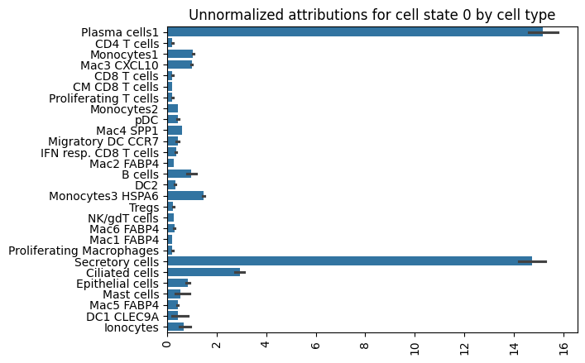
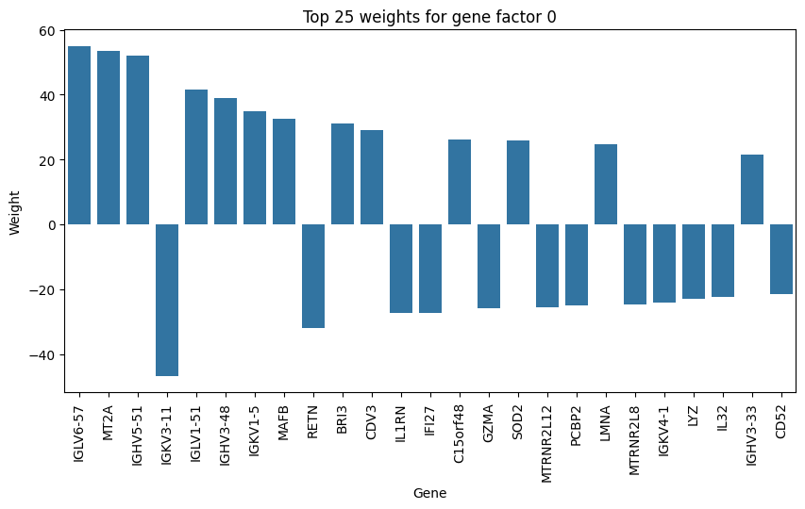
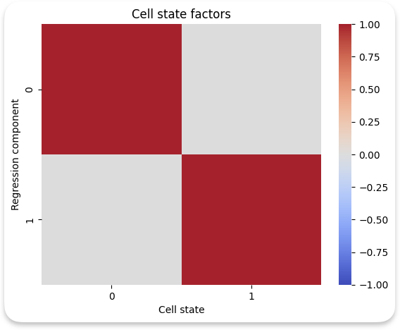
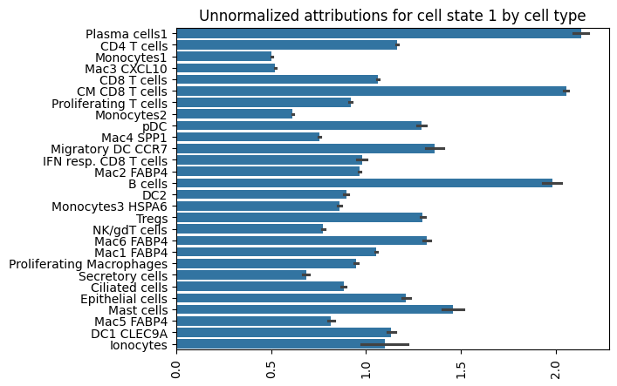
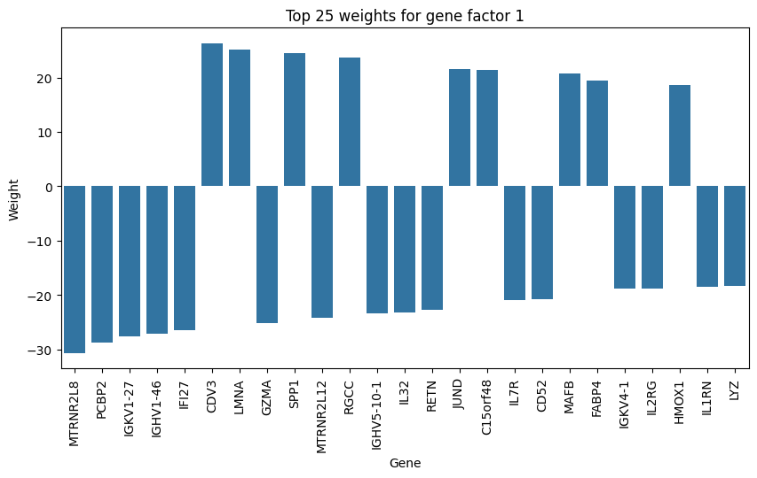
Predicting all-cause pneumonia mortality
ROC AUC (10-fold): 0.791
Cell state factors are forced to be diagonal, so gene factor i only operates on the expression for cell state i
Notes:
Bunch of immunoglobulin genes
GENE FACTOR 0
MT2A is oxidative stress
MAFB: This gene is involved in lineage-specific hematopoiesis. Upregulation might affect immune cell development and function.
RETN: Resistin is associated with inflammation. Decreased expression might indicate a less severe inflammatory response
BRI3 (+1): Function not well characterized, but it's involved in TNF-induced cell death. Upregulation might be associated with increased cell death.
IL1RN (-1): Interleukin 1 receptor antagonist. Decreased expression might lead to uncontrolled inflammation.
GENE FACTOR 1
MTRNR2L8 (-1): A humanin-like protein. Decreased expression might reduce cellular stress response capabilities, potentially affecting cell survival in pneumonia.
PCBP2 (-1): Poly(rC)-binding protein 2, involved in mRNA stabilization. Downregulation might disrupt normal gene expression regulation, potentially affecting the overall cellular response to infection.
IGKV1-27 (-1): An immunoglobulin kappa variable gene. Decreased expression might indicate a less effective antibody response, potentially compromising the adaptive immune response to pneumonia.
IGHV1-46 (-1): An immunoglobulin heavy chain variable gene. Downregulation might suggest a reduced antibody response, possibly leading to less effective pathogen clearance.
IFI27 (-1): Interferon alpha-inducible protein 27. Reduced expression might indicate a weakened antiviral response, which could be relevant if viral pneumonia is involved.
CDV3 (+1): Function not well characterized. Its upregulation in association with mortality risk suggests it may play a role in the disease process, but the specific mechanism is unclear.
LMNA (+1): Lamin A/C, involved in nuclear stability. Increased expression might indicate cellular stress or altered nuclear function, potentially reflecting more severe cellular damage.
GZMA (-1): Granzyme A, involved in cytotoxic T cell-mediated apoptosis. Decreased expression might indicate reduced T cell activity, potentially compromising the cellular immune response.
SPP1 (+1): Osteopontin, involved in inflammation and immune regulation. Upregulation might indicate increased inflammation, potentially contributing to lung damage.
MTRNR2L12 (-1): Another humanin-like protein. Decreased expression might affect cellular stress response, potentially reducing cell survival under stress conditions.

Slide 16
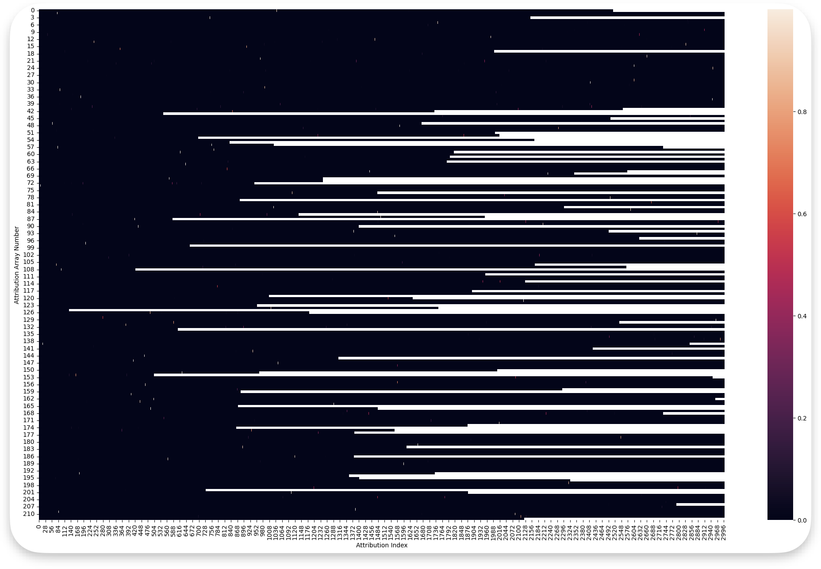
Gini index: 0.995

Slide 17
Future directions
Hyperparameter tuning is very difficult right now. There might be a better way to do this.
Better visualization strategies:
Plotting cell states on UMAP.

